Slide 1
Extract, Transform, Load Project
Duwli Toe – Melat Yohannes – Daphne Mixon-Tinsley

Slide 2
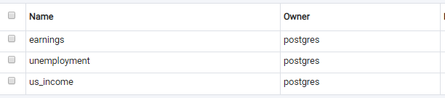
ETL Project
Data Selection
For this project our team reviewed various unemployment and income datasets on Kaggle.com.
After careful review we selected the following datasets:
US Unemployment Rate by County 1990 – 2016 – CSV
https://www.kaggle.com/jayrav13/unemployment-by-county-us
US Household Income Stats geo locations – CSV
https://www.kaggle.com/goldenoakresearch/us-household-income-stats-geo-locations
An additional dataset was selected from the US Census Bureau library of information.
Median Household Income by State 1984 through 2015 – Excel
https://www.census.gov/data/tables/time-series/demo/income-poverty/historical-income-households.html
Extraction - Setup
We set up tables for each of our datasets in Postgres SQL to be used in the load phase of our project.

Slide 3
ETL Project
Extraction – Setup
Our Postgre tables contained the following columns:
Earnings
State
Median
Unemployment
Year
State
County
Rate
US Income
State_Name
County
Mean

Slide 4
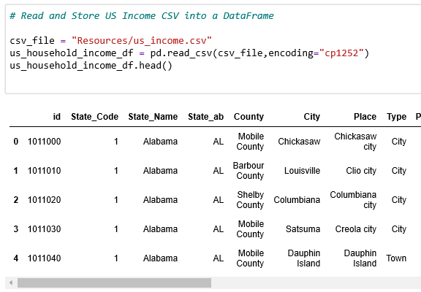
ETL Project
Extraction and Transformation
Using Pandas in Jupyter Notebook we loaded our three files. We loaded one excel and two CSV files.
After loading the files we transformed each into data frames.

Slide 5
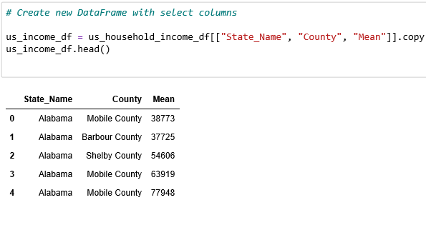
ETL Project
Transformation
After the DataFrames were created for each file we further transformed the files by cleaning them by dropping columns which contained data we did not need.
From the US Household Income CSV, we dropped the ID, State_Code, State_ab, City, Place, Type, Primary, Zip_Code, Area_Code, ALand, AWater, Lat, Lon, Median, Stdev, and sum_w columns.

Slide 6
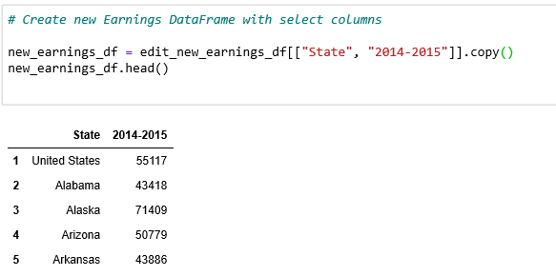
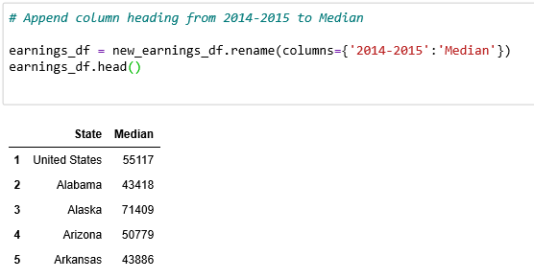
ETL Project
Transformation
From the US Household Income Stats geo location CSV we dropped the ID, State_Code, State_ab, City, Place, Type, Primary, Zip_Code, Area_Code, ALand, AWater, Lat, Lon, Median, Stdev, and sum_w columns.
From the US Unemployment Rate by County 1990 – 2016 CSV we dropped the State column.
Median Household Income by State 1984 through 2015 – Excel file we dropped the Median income and Standard error columns for 1984 – 2013.
We further transformed the Median Household Income by State file by changing the column heading of 2014-2015 to Median.

Slide 7
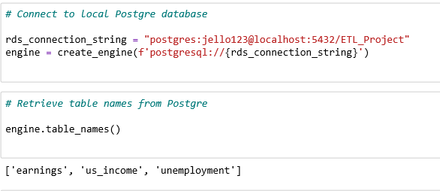
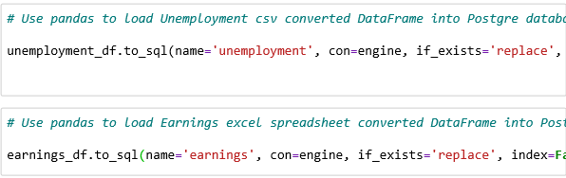
ETL Project
Load
Once all of the CSV files were reviewed, we created a connection to our Postgres Database.
Next we queried the table names to ensure we were connected to the correct database.
The next step in our ETL process was to load each DataFrame into our Postgre Database.

Slide 8
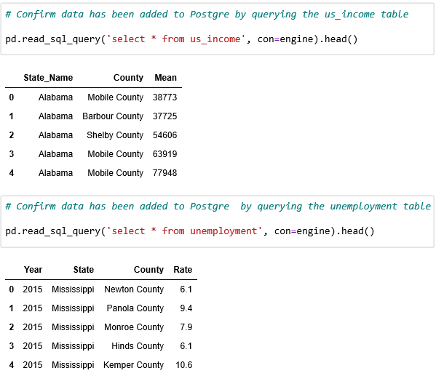
ETL Project
Load
Our final step was to query our Postgre DataBase in Jupyter Notebook to very all of our data was loaded correctly.

Slide 9
ETL Project
Summary
Our team combined data from multiple sources on income and unemployment in the US for 2014 – 2015. We can use our combined database to look at a specific state data or drill down further and look at specific counties within a select state. This database can be used to compare states, regions, counties, etc. By following the ETL process, you can combine and transform data from various sources for analytical purposes.

Slide 10
Questions

